Slide 1
ResQReach
INFO6150 Web Design

Slide 2
Project Description
ResQReach is a Progressive Web Application aimed at enhancing disaster response and preparedness through active community engagement. This application empowers users to report emergencies, access preparedness resources and facilitate sharing of leftover food from restaurants, thus playing a crucial role in crisis management.
Features: 1. Emergency Reporting System
2. Disaster Preparedness Guides
3. Food Share Functionality
4. Real-Time Alerts and Notifications
5. Enhancing Community Safety and Well-Being
6. User Reviews
7. Internationalization

Slide 3
Team Members
Kaushik Malikireddy NUID: 002248429
Vinay Gangadhara NUID: 002837586
Vamsi Naradasu NUID: 002202111
Nirnay Reddy Gaddam NUID: 002879525

Slide 4
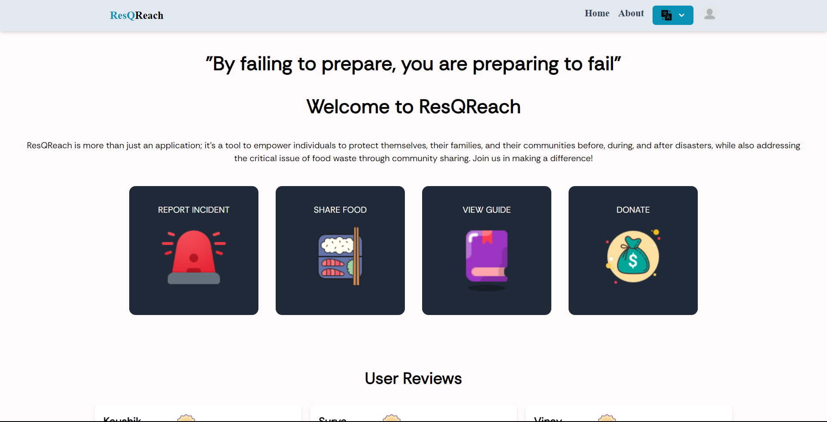
Project Images

Slide 5
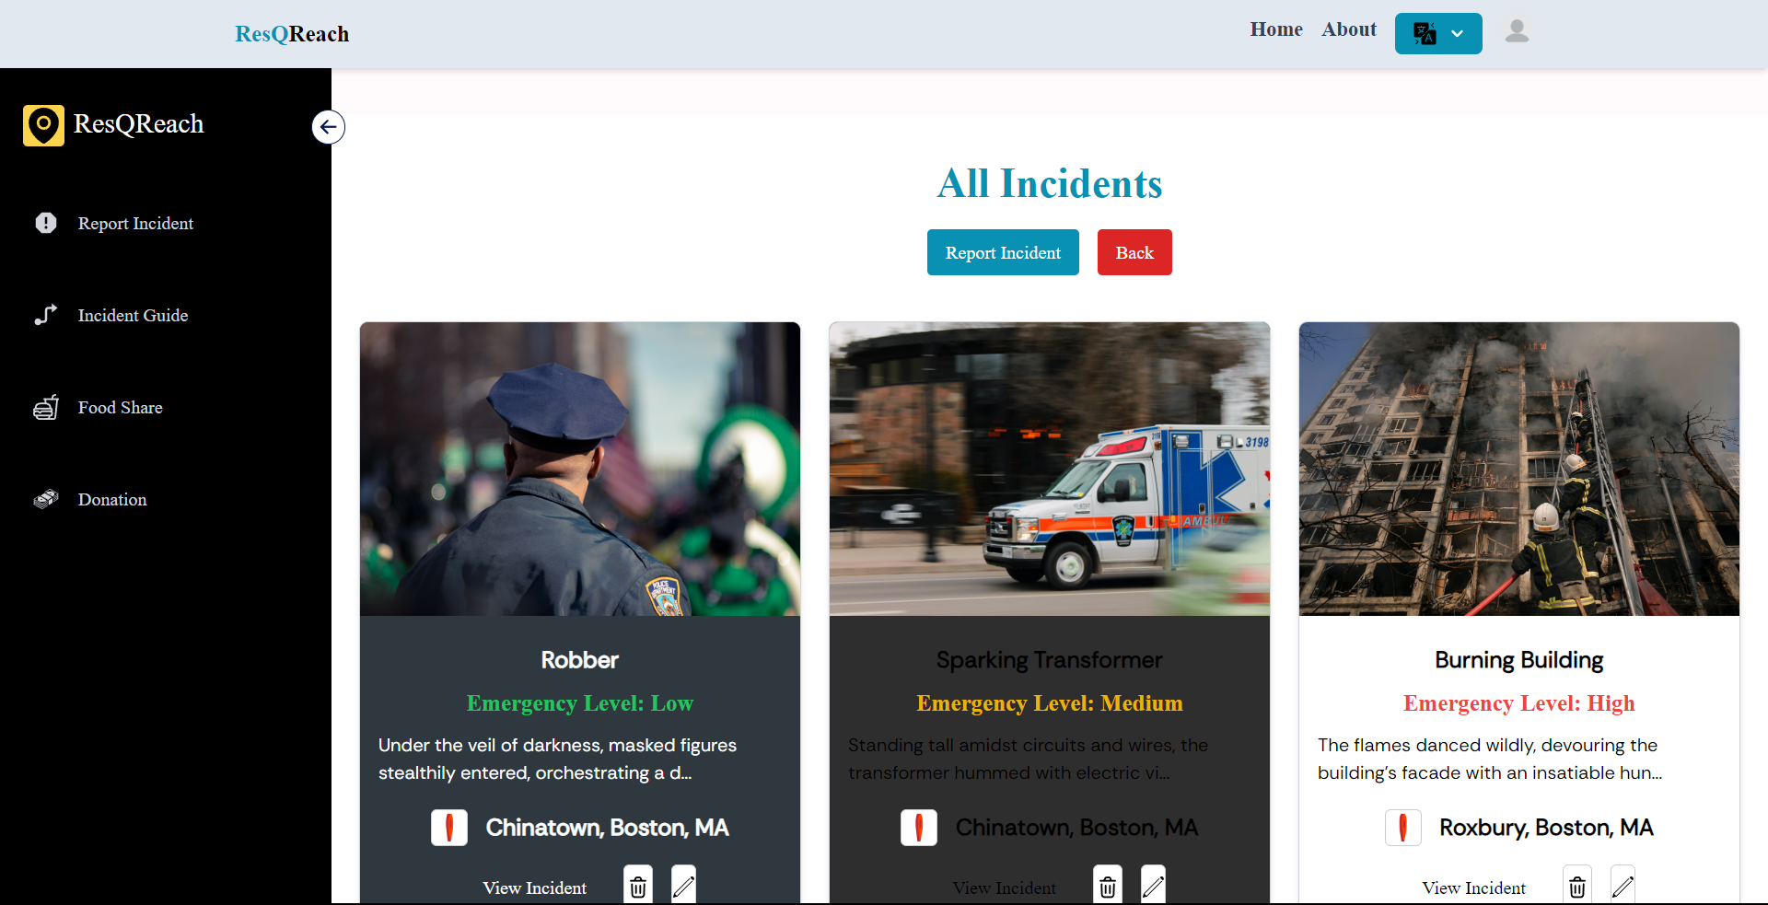
Incident Reports

Slide 6
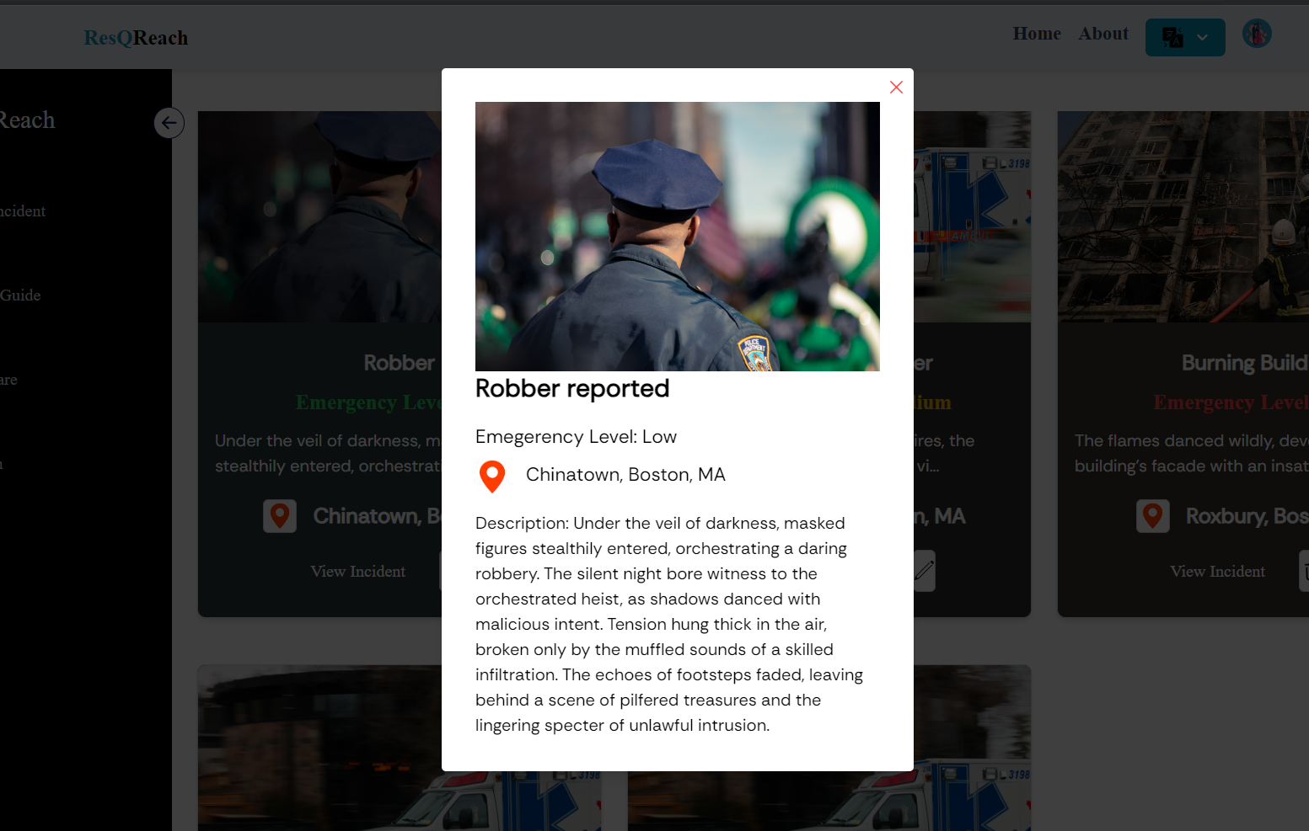

Slide 7
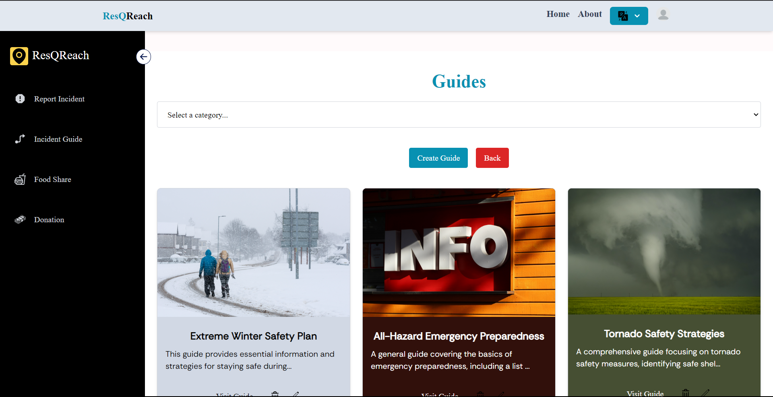
Incident Guides

Slide 8
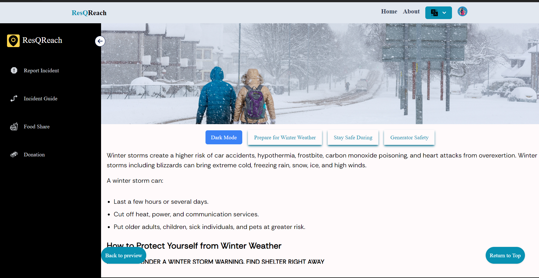

Slide 9
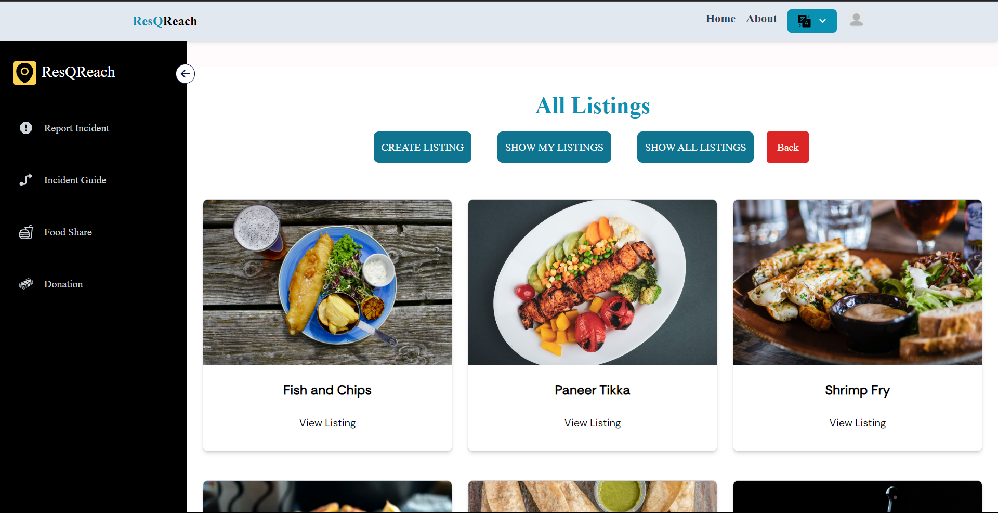
Feed Share

Slide 10
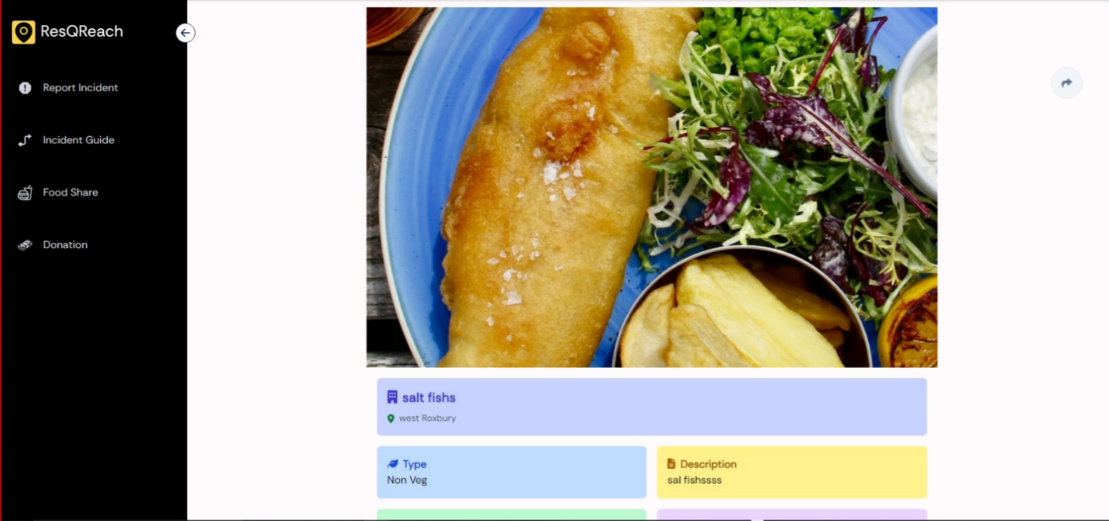

Slide 11
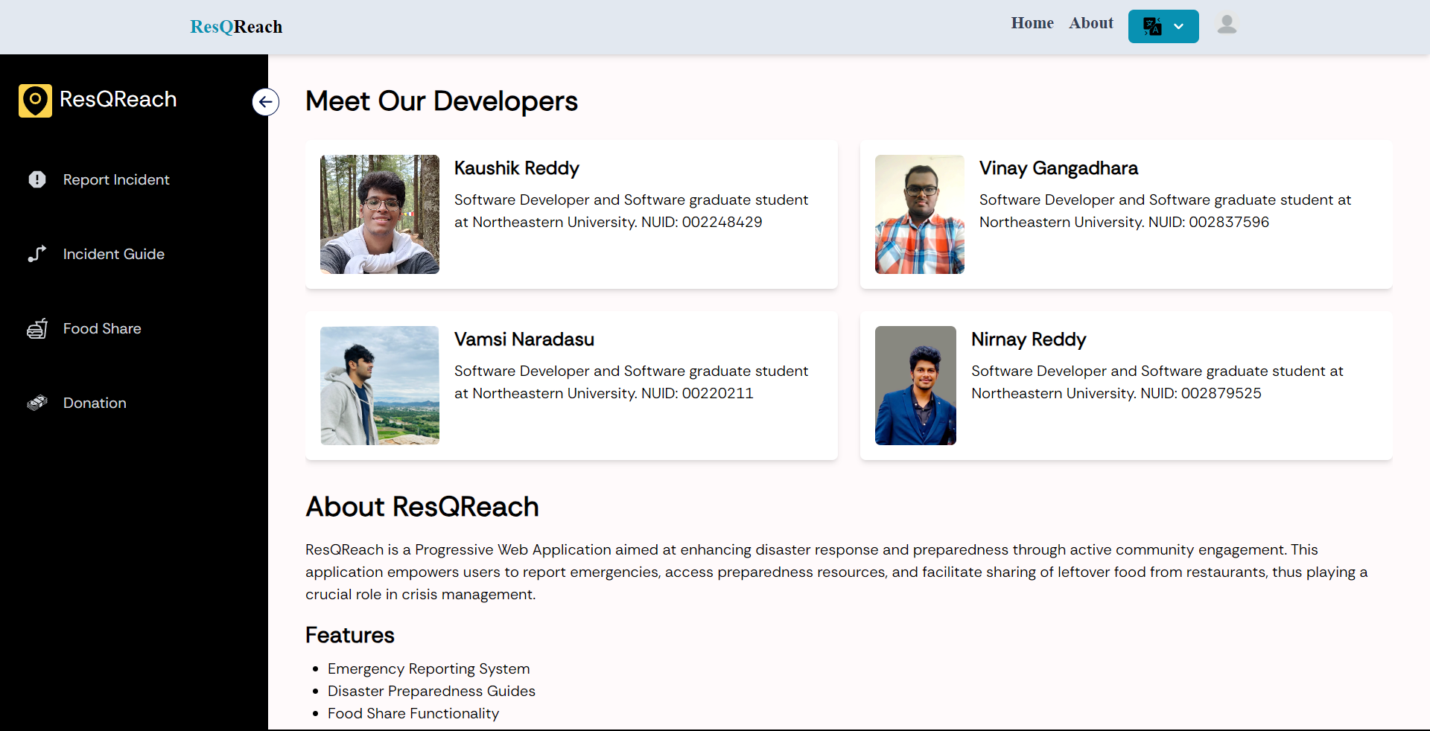
About the developers Page

Slide 12
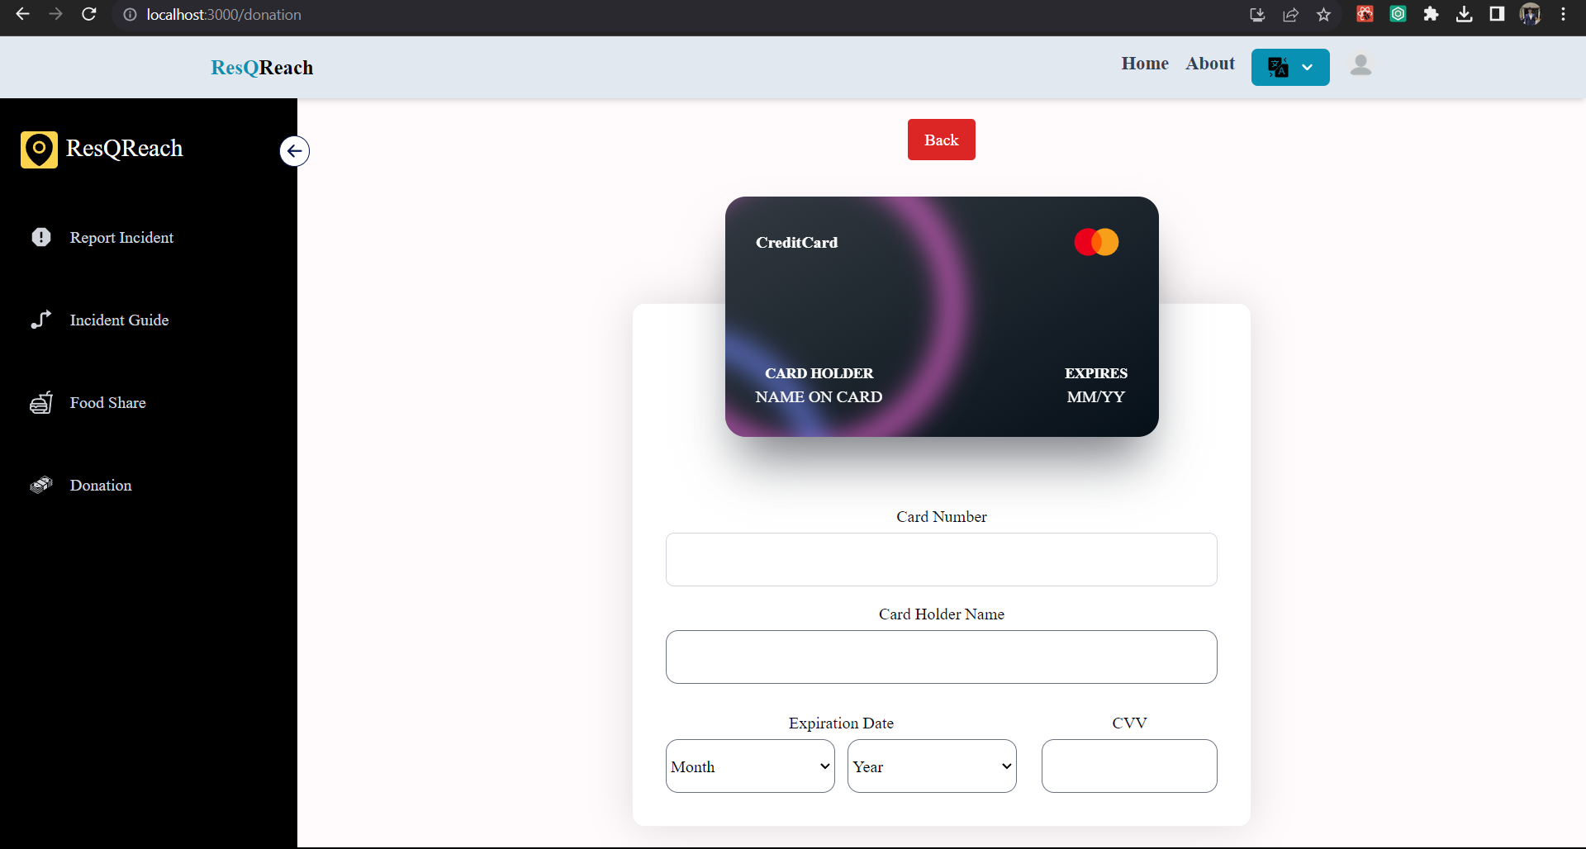

Slide 13
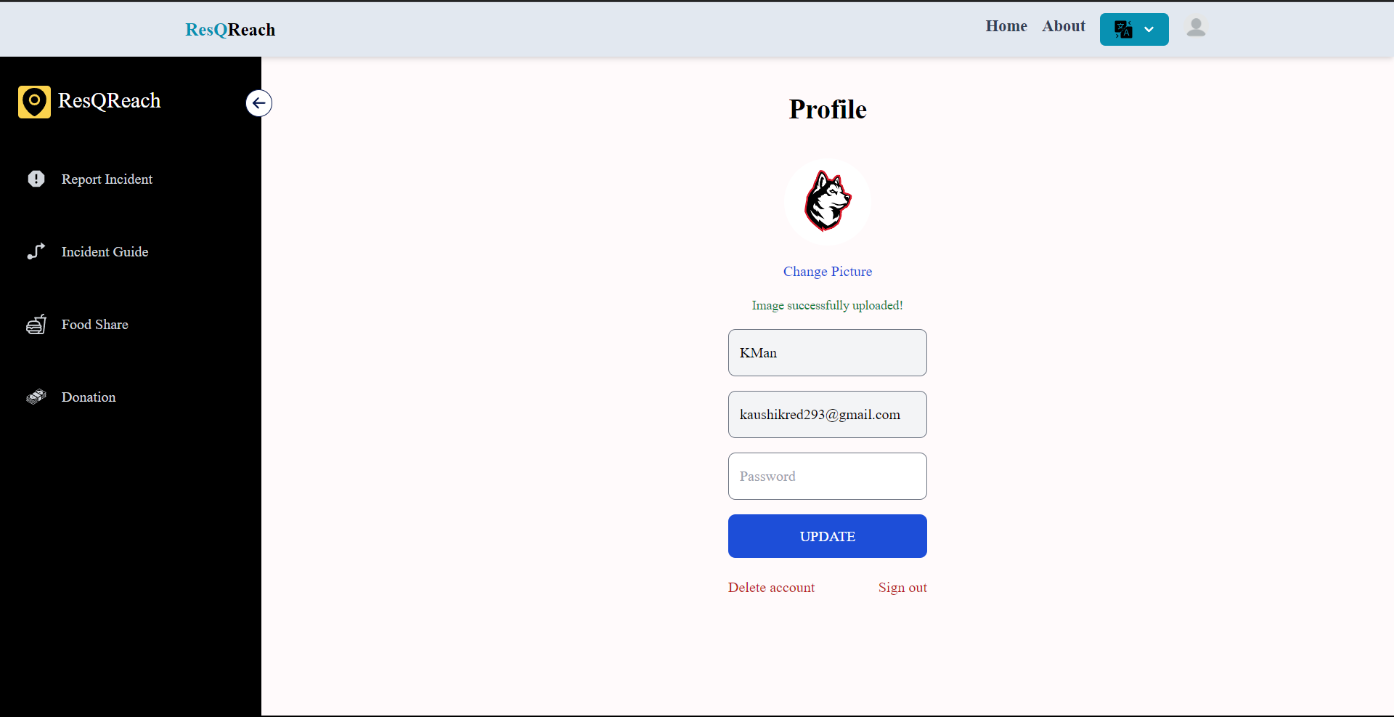
User profile

Slide 14
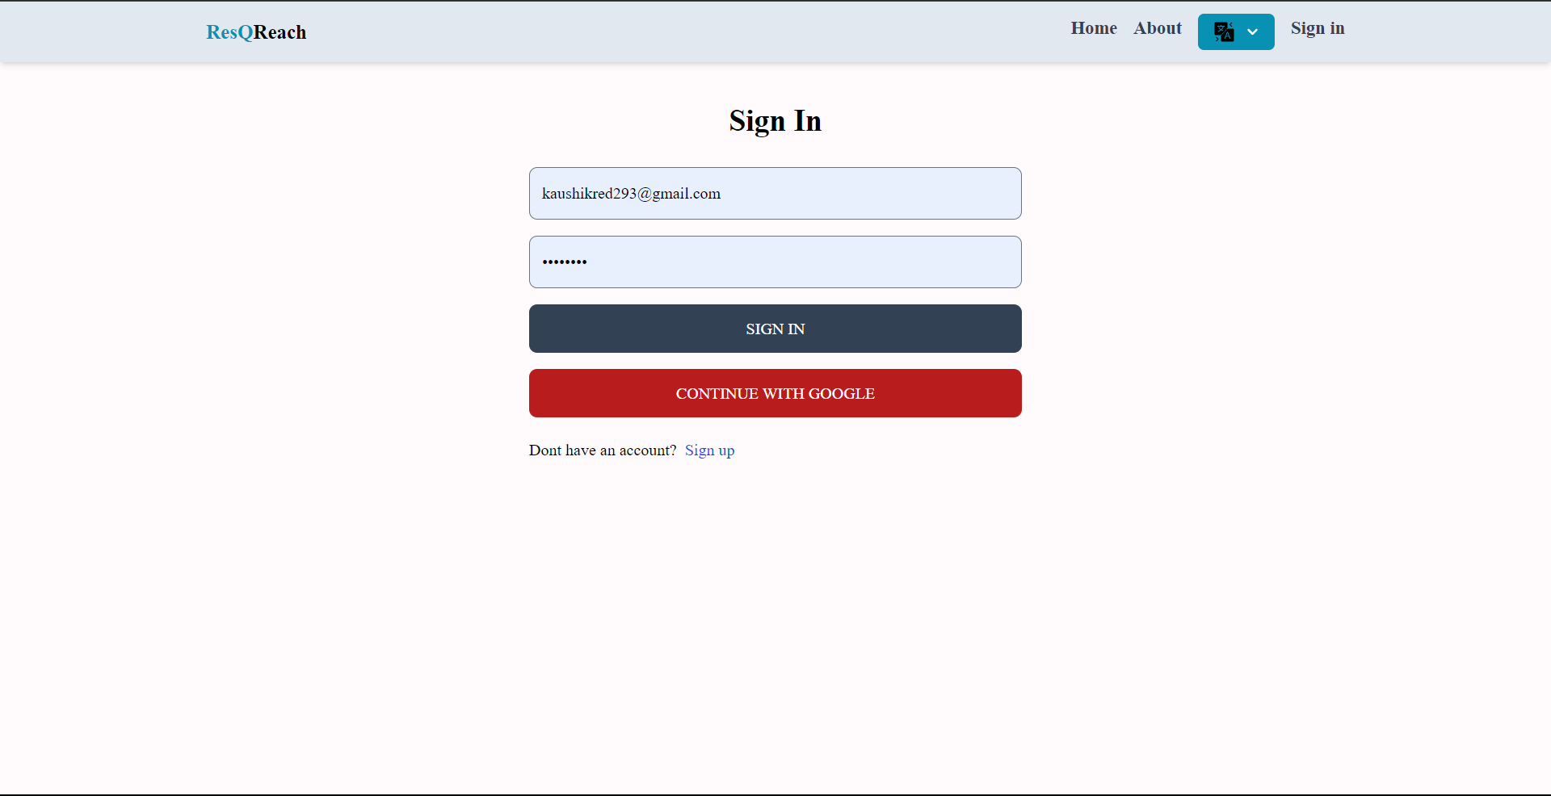
Sign In

Slide 15
Thank You

